Slide 1
My SQL
Made by: Eng. Doaa m.Abd elfatah

Slide 2
Creating View

Slide 3
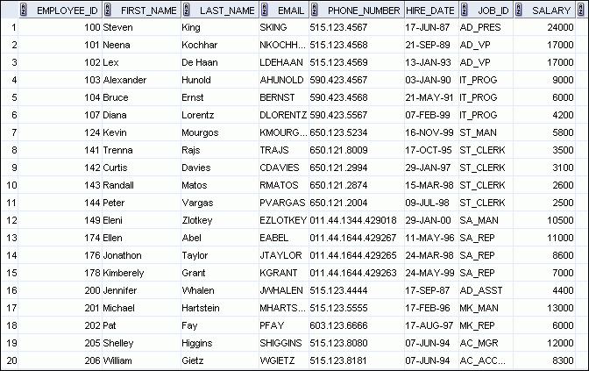
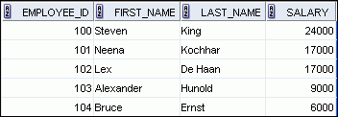
What Is a View?
EMPLOYEES table
Notes:
What Is a View?
You can present logical subsets or combinations of data by creating views of tables. A view is a logical table based on a table or another view. A view contains no data of its own, but is like a window through which data from tables can be viewed or changed. The tables on which a view is based are called base tables. The view is stored as a SELECT statement in the data dictionary.

Slide 4

Advantages of Views
To restrict
data access
To make complex queries easy
To provide data independence
To present different views of the same data
Notes:
Advantages of Views
Views restrict access to the data because it displays selected columns from the table.
Views can be used to make simple queries to retrieve the results of complicated queries. For example, views can be used to query information from multiple tables without the user knowing how to write a join statement.
Views provide data independence for ad hoc users and application programs. One view can be used to retrieve data from several tables.
Views provide groups of users access to data according to their particular criteria.
For more information, see the section on “CREATE VIEW” in the Oracle Database SQL Language Reference 11g, Release 1 (11.1).

Slide 5
Creating a View
You embed a subquery in the CREATE VIEW statement:
The subquery can contain complex SELECT syntax.
CREATE VIEW view [(alias[, alias]...)]
AS subquery
[WITH CHECK OPTION];
Notes:
Creating a View
You can create a view by embedding a subquery in the CREATE VIEW statement.
In the syntax:
OR REPLACE Re-creates the view if it already exists
FORCE Creates the view regardless of whether or not the base tables exist
NOFORCE Creates the view only if the base tables exist (This is the default.)
view Is the name of the view
alias Specifies names for the expressions selected by the view’s query (The number of aliases must match the number of expressions selected by the view.)
subquery Is a complete SELECT statement (You can use aliases for the columns in the SELECT list.)
WITH CHECK OPTION Specifies that only those rows that are accessible to the view can be inserted or updated
constraint Is the name assigned to the CHECK OPTION constraint
WITH READ ONLY ensures that no DML operations can be performed on this view
Note: In SQL Developer, click the Run Script icon or press [F5] to run the data definition language (DDL) statements. The feedback messages will be shown on the Script Output tabbed page.

Slide 6
Creating a View
Create the EMPVU80 view, which contains details of the employees in department 80:
Describe the structure of the view by using the iSQL*Plus DESCRIBE command:
CREATE VIEW empvu80
AS SELECT employee_id, last_name, salary
FROM employees
WHERE department_id = 80;
DESCRIBE empvu80
Notes:
Creating a View (continued)
The example in the slide creates a view that contains the employee number, last name, and salary for each employee in department 80.
You can display the structure of the view by using the DESCRIBE command.
Guidelines
The subquery that defines a view can contain complex SELECT syntax, including joins, groups, and subqueries.
If you do not specify a constraint name for the view created with the WITH CHECK OPTION, the system assigns a default name in the SYS_Cn format.
You can use the OR REPLACE option to change the definition of the view without dropping and re-creating it, or regranting the object privileges previously granted on it.

Slide 7
Creating a View
Create a view by using column aliases in the subquery:
Select the columns from this view by the given alias names.
CREATE VIEW salvu50
AS SELECT employee_id ID_NUMBER, last_name NAME,
salary*12 ANN_SALARY
FROM employees
WHERE department_id = 50;
Notes:
Creating a View (continued)
You can control the column names by including column aliases in the subquery.
The example in the slide creates a view containing the employee number (EMPLOYEE_ID) with the alias ID_NUMBER, name (LAST_NAME) with the alias NAME, and annual salary (SALARY) with the alias ANN_SALARY for every employee in department 50.
Alternatively, you can use an alias after the CREATE statement and before the SELECT subquery. The number of aliases listed must match the number of expressions selected in the subquery.
CREATE OR REPLACE VIEW salvu50 (ID_NUMBER, NAME, ANN_SALARY)
AS SELECT employee_id, last_name, salary*12
FROM employees
WHERE department_id = 50;

Slide 8
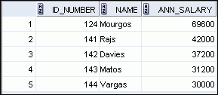
Retrieving Data from a View
SELECT *
FROM salvu50;
Notes:
Retrieving Data from a View
You can retrieve data from a view as you would from any table. You can display either the contents of the entire view or just specific rows and columns.

Slide 9
Using the WITH CHECK OPTION Clause
You can ensure that DML operations performed on the view stay in the domain of the view by using the WITH CHECK OPTION clause:
Any attempt to INSERT a row with a department_id other than 20, or to UPDATE the department number for any row in the view fails because it violates the WITH CHECK OPTION constraint.
ALTER VIEW empvu20
AS SELECT *
FROM employees
WHERE department_id = 20
WITH CHECK OPTION CONSTRAINT empvu20_ck ;
Notes:
Using the WITH CHECK OPTION Clause
It is possible to perform referential integrity checks through views. You can also enforce constraints at the database level. The view can be used to protect data integrity, but the use is very limited.
The WITH CHECK OPTION clause specifies that INSERTs and UPDATEs performed through the view cannot create rows that the view cannot select. Therefore it enables integrity constraints and data validation checks to be enforced on data being inserted or updated. If there is an attempt to perform DML operations on rows that the view has not selected, an error is displayed, along with the constraint name if that has been specified.
UPDATE empvu20
SET department_id = 10
WHERE employee_id = 201;
causes:
Note: No rows are updated because, if the department number were to change to 10, the view would no longer be able to see that employee. With the WITH CHECK OPTION clause, therefore, the view can see only the employees in department 20 and does not allow the department number for those employees to be changed through the view.

Slide 10
Removing a View
You can remove a view without losing data because a view is based on underlying tables in the database.
DROP VIEW view;
DROP VIEW empvu80;
Notes:
Removing a View
You use the DROP VIEW statement to remove a view. The statement removes the view definition from the database. However, dropping views has no effect on the tables on which the view was based. On the other hand, views or other applications based on the deleted views become invalid. Only the creator or a user with the DROP ANY VIEW privilege can remove a view.
In the syntax:
view is the name of the view

Slide 11
Creating Procedures

Slide 12


What Are Procedures?
Are a type of subprogram that perform an action
Can be stored in the database as a schema object
Promote reusability and maintainability
Procedures
Notes:
Definition of a Procedure
A procedure is a named PL/SQL block that can accept parameters (sometimes referred to as arguments). Generally, you use a procedure to perform an action. It has a header, a declaration section, an executable section, and an optional exception-handling section. A procedure is invoked by using the procedure name in the execution section of another PL/SQL block.
A procedure is compiled and stored in the database as a schema object. If you are using the procedures with Oracle Forms and Reports, then they can be compiled within the Oracle Forms or Oracle Reports executables.
Procedures promote reusability and maintainability. When validated, they can be used in any number of applications. If the requirements change, only the procedure needs to be updated.

Slide 13
Example
DELIMITER //
CREATE PROCEDURE country_hos
(IN con CHAR(20))
BEGIN
SELECT Name, HeadOfState FROM Country
WHERE Continent = con;
END //
DELIMITER ;
CALL country_hos('Europe');

Slide 14
Declaring variables
To declare a variable inside a stored procedure, you use the DECLARE statement as follows:
DECLARE variable_name datatype(size) DEFAULT default_value;
DECLARE total_sale INT DEFAULT 0;
DECLARE x, y INT DEFAULT 0;

Slide 15
Assigning variables
DECLARE total_count INT DEFAULT 0;
SET total_count = 10;
OR
DECLARE total_products INT DEFAULT 0;
SELECT COUNT(*) INTO total_products FROM products;

Slide 16
Variables scope
A variable has its own scope that defines its lifetime. If you declare a variable inside a stored procedure, it will be out of scope when the END statement of stored procedure reached.
A variable that begins with the @ sign is session variable. It is available and accessible until the session ends.

Slide 17
Comparing the Parameter Modes
IN
OUT
IN OUT
Default mode
Must be specified
Must be specified
Value is passed into subprogram
Value is returned to the calling environment
Value passed into sub-program; value returned to calling environment
Formal parameter acts as a constant
Uninitialized variable
Initialized variable
Actual parameter can be a literal, expression, constant, or initialized variable
Must be a variable
Must be a variable
Can be assigned a default value
Cannot be assigned
a default value
Cannot be assigned
a default value
Notes:
Comparing the Parameter Modes
The IN parameter mode is the default mode if no mode is specified in the declaration. The OUT and IN OUT parameter modes must be explicitly specified with the parameter declaration.
A formal parameter of IN mode cannot be assigned a value and cannot be modified in the body of the procedure. By default, the IN parameter is passed by reference. An IN parameter can be assigned a default value in the formal parameter declaration, in which case the caller need not provide a value for the parameter if the default applies.
An OUT or IN OUT parameter must be assigned a value before returning to the calling environment. The OUT and IN OUT parameters cannot be assigned default values. To improve performance with OUT and IN OUT parameters, the NOCOPY compiler hint can be used to request to pass by reference.
Note: Using NOCOPY is discussed later in this course.

Slide 18
The IN parameter example
DELIMITER //
CREATE PROCEDURE GetOfficeByCountry(IN countryName VARCHAR(255))
BEGIN
SELECT *
FROM offices
WHERE country = countryName;
END //
DELIMITER ;
--To call Procedure:
CALL GetOfficeByCountry('USA');

Slide 19
The OUT parameter example
DELIMITER $$
CREATE PROCEDURE CountOrderByStatus(
IN orderStatus VARCHAR(25),
OUT total INT)
BEGIN
SELECT count(orderNumber)
INTO total
FROM orders
WHERE status = orderStatus;
END$$
DELIMITER ;
CALL CountOrderByStatus('Shipped',@total);
SELECT @total;

Slide 20
The INOUT parameter example
DELIMITER $$
CREATE PROCEDURE set_counter(INOUT count INT(4),IN inc INT(4))
BEGIN
SET count = count + inc;
END$$
DELIMITER ;
SET @counter = 1;
CALL set_counter(@counter,1); -- 2
CALL set_counter(@counter,1); -- 3
CALL set_counter(@counter,5); -- 8
SELECT @counter; -- 8

Slide 21
DELIMITER $$
CREATE PROCEDURE get_order_by_cust ( IN cust_no INT, OUT shipped INT, OUT canceled INT, OUT resolved INT, OUT disputed INT)
BEGIN
SELECT count(*) INTO shipped FROM orders
WHERE customerNumber = cust_no AND status = 'Shipped';
SELECT count(*) INTO canceled FROM orders
WHERE customerNumber = cust_no AND status = 'Canceled';
SELECT count(*) INTO resolved FROM orders
WHERE customerNumber = cust_no AND status = 'Resolved';
SELECT count(*) INTO disputed FROM orders
WHERE customerNumber = cust_no AND status = 'Disputed';
END $$
CALL get_order_by_cust(141,@shipped,@canceled,
@resolved,@disputed);
SELECT @shipped,@canceled,@resolved,@disputed;

Slide 22
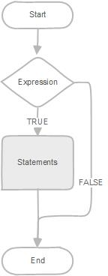
IF Statement
IF expression THEN
statements;
END IF;

Slide 23
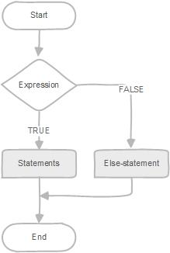
MySQL IF ELSE statement
IF expression THEN
statements;
ELSE
else-statements;
END IF;

Slide 24
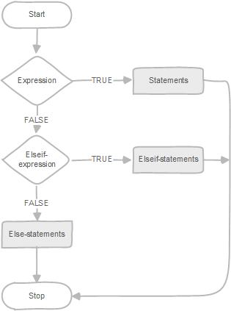
MySQL IF ELSEIF ELSE statement
IF expression THEN
statements;
ELSEIF elseif-expression THEN
elseif-statements;
...
ELSE
else-statements;
END IF;

Slide 25
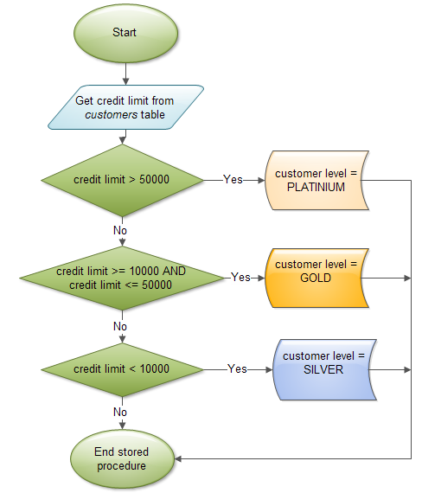
DELIMITER $$
CREATE PROCEDURE GetCustomerLevel(
in p_customerNumber int(11),
out p_customerLevel varchar(10))
BEGIN
DECLARE creditlim double;
SELECT creditlimit INTO creditlim
FROM customers
WHERE customerNumber = p_customerNumber;
IF creditlim > 50000 THEN
SET p_customerLevel = 'PLATINUM';
ELSEIF (creditlim <= 50000 AND creditlim >= 10000) THEN
SET p_customerLevel = 'GOLD';
ELSEIF creditlim < 10000 THEN
SET p_customerLevel = 'SILVER';
END IF;
END$$

Slide 26
Loop in Stored Procedures
MySQL provides loop statements that allow you to execute a block of SQL code repeatedly based on a condition. There are three loop statements in MySQL: WHILE, REPEAT and LOOP.

Slide 27
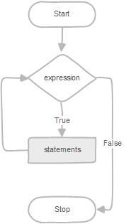
WHILE loop
WHILE expression DO
statements
END WHILE

Slide 28

DELIMITER $$
DROP PROCEDURE IF EXISTS test_mysql_while_loop$$
CREATE PROCEDURE test_mysql_while_loop()
BEGIN
DECLARE x INT;
DECLARE str VARCHAR(255);
SET x = 1;
SET str = '';
WHILE x <= 5 DO
SET str = CONCAT(str,x,',');
SET x = x + 1;
END WHILE;
SELECT str;
END$$
DELIMITER ;
CALL test_mysql_while_loop();

Slide 29
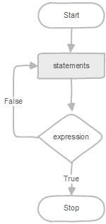
REPEAT loop
REPEAT
statements;
UNTIL expression
END REPEA

Slide 30
DELIMITER $$
DROP PROCEDURE IF EXISTS mysql_test_repeat_loop$$
CREATE PROCEDURE mysql_test_repeat_loop()
BEGIN
DECLARE x INT;
DECLARE str VARCHAR(255);
SET x = 1;
SET str = '';
REPEAT
SET str = CONCAT(str,x,',');
SET x = x + 1;
UNTIL x > 5
END REPEAT;
SELECT str;
END$$
DELIMITER ;
CALL mysql_test_repeat_loop();

Slide 31
LOOP, LEAVE and ITERATE statements
The LEAVE statement allows you to exit the loop immediately without waiting for checking the condition. The LEAVE statement works like the break statement in other languages such as PHP, C/C++, Java, etc.
The ITERATE statement allows you to skip the entire code under it and start a new iteration. The ITERATE statement is similar to the continue statement in PHP, C/C++, Java, etc.

Slide 32
CREATE PROCEDURE test_mysql_loop()
BEGIN
DECLARE x INT;
DECLARE str VARCHAR(255);
SET x = 1;
SET str = '';
loop_label: LOOP
IF x > 10 THEN
LEAVE loop_label;
END IF;
SET x = x + 1;
IF (x mod 2) THEN
ITERATE loop_label;
ELSE
SET str = CONCAT(str,x,',');
END IF;
END LOOP;
SELECT str;
END;

Slide 33
Creating functions

Slide 34
Overview of Stored Functions
A function:
Is a named block that returns a value
Can be stored in the database as a schema object for repeated execution
Is called as part of an expression or is used to provide a parameter value for another subprogram
Notes:
Overview of Stored Functions
A function is a named PL/SQL block that can accept parameters, be invoked, and return a value. In general, you use a function to compute a value. Functions and procedures are structured alike. A function must return a value to the calling environment, whereas a procedure returns zero or more values to its calling environment. Like a procedure, a function has a header, a declarative section, an executable section, and an optional exception-handling section. A function must have a RETURN clause in the header and at least one RETURN statement in the executable section.
Functions can be stored in the database as schema objects for repeated execution. A function that is stored in the database is referred to as a stored function. Functions can also be created on client-side applications.
Functions promote reusability and maintainability. When validated, they can be used in any number of applications. If the processing requirements change, only the function needs to be updated.
A function may also be called as part of a SQL expression or as part of a PL/SQL expression. In the context of a SQL expression, a function must obey specific rules to control side effects. In a PL/SQL expression, the function identifier acts like a variable whose value depends on the parameters passed to it.
Functions (and procedures) can be grouped into PL/SQL packages. Packages make code even more reusable and maintainable. Packages are covered in the lessons titled “Creating Packages” and “Working with Packages.”

Slide 35
MySQL stored function syntax
CREATE FUNCTION function_name(param1,param2,…)
RETURNS datatype
[NOT] DETERMINISTIC
statements
for the same input parameters, if the stored function returns the same result, it is considered deterministic and otherwise the stored function is not deterministic.
You have to decide whether a stored function is deterministic or not.
If you declare it incorrectly, the stored function may produce an unexpected result, or the available optimization is not used which degrades the performance.

Slide 36
DELIMITER $$
CREATE FUNCTION CustomerLevel(p_creditLimit double) RETURNS VARCHAR(10)
DETERMINISTIC
BEGIN
DECLARE lvl varchar(10);
IF p_creditLimit > 50000 THEN
SET lvl = 'PLATINUM';
ELSEIF (p_creditLimit <= 50000 AND p_creditLimit >= 10000) THEN
SET lvl = 'GOLD';
ELSEIF p_creditLimit < 10000 THEN
SET lvl = 'SILVER';
END IF;
RETURN (lvl);
END
call the CustomerLevel() in an SQL SELECT statement
SELECT
customerName, CustomerLevel(creditLimit)
FROM
customers
ORDER BY customerName;

Slide 37
Creating triggers

Slide 38


What Are Triggers?
A trigger is block that is stored in the database and fired (executed) in response to a specified event.
The MySQL database automatically executes a trigger when specified conditions occur.
Notes:
Working with Triggers: Overview
Triggers are similar to stored procedures. A trigger stored in the database contains PL/SQL in the form of an anonymous block, a call statement, or a compound trigger block. However, procedures and triggers differ in the way that they are invoked. A procedure is explicitly run by a user, application, or trigger. Triggers are implicitly fired by the Oracle database when a triggering event occurs, no matter which user is connected or which application is being used.

Slide 39
Trigger Event Types and Body
A trigger event type determines which DML statement causes the trigger to execute. The possible events are:
INSERT
UPDATE [OF column]
DELETE
For example, the TRUNCATE statement removes all data of a table but does not invoke the trigger associated with that table.
A trigger body determines what action is performed and is a PL/SQL block or a CALL to a procedure.
Notes:
Triggering Event Types
The triggering event or statement can be an INSERT, UPDATE, or DELETE statement on a table.
When the triggering event is an UPDATE statement, you can include a column list to identify which columns must be changed to fire the trigger. You cannot specify a column list for an INSERT or for a DELETE statement because it always affects entire rows.
. . . UPDATE OF salary . . .
The triggering event can contain one, two, or all three of these DML operations.
. . . INSERT or UPDATE or DELETE
. . . INSERT or UPDATE OF job_id . . .
The trigger body defines the action—that is, what needs to be done when the triggering event is issued. The PL/SQL block can contain SQL and PL/SQL statements, and can define PL/SQL constructs such as variables, cursors, exceptions, and so on. You can also call a PL/SQL procedure or a Java procedure.
Note: The size of a trigger cannot be greater than 32 KB.

Slide 40
Triggers types
Before MySQL version 5.7.2, you can to define maximum six triggers for each table.
BEFORE INSERT – activated before data is inserted into the table.
AFTER INSERT – activated after data is inserted into the table.
BEFORE UPDATE – activated before data in the table is updated.
AFTER UPDATE – activated after data in the table is updated.
BEFORE DELETE – activated before data is removed from the table.
AFTER DELETE – activated after data is removed from the table.
However, from MySQL version 5.7.2+, you can define multiple triggers for the same trigger event and action time.

Slide 41
MySQL trigger syntax
CREATE TRIGGER trigger_name trigger_time trigger_event
ON table_name
FOR EACH ROW
BEGIN
...
END;

Slide 42
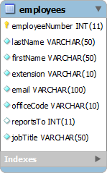
MySQL trigger example
CREATE TABLE employees_audit (
id INT AUTO_INCREMENT PRIMARY KEY,
employeeNumber INT NOT NULL,
lastname VARCHAR(50) NOT NULL,
changedat DATETIME DEFAULT NULL,
action VARCHAR(50) DEFAULT NULL
);

Slide 43
MySQL trigger example
DELIMITER $$
CREATE TRIGGER before_employee_update
BEFORE UPDATE ON employees
FOR EACH ROW
BEGIN
INSERT INTO employees_audit
SET action = 'update',
employeeNumber = OLD.employeeNumber,
lastname = OLD.lastname,
changedat = NOW();
END$$
DELIMITER ;
to view all triggers in the current database, you use SHOW TRIGGERS statement
SHOW TRIGGERS;

Slide 44
Creating events

Slide 45
What is event?
A MySQL event is a task that runs based on a predefined schedule therefore sometimes it is referred to as a scheduled event. MySQL event is also known as “temporal trigger” because it is triggered by time, not by table update like a trigger. A MySQL event is similar to a cron job in UNIX or a task scheduler in Windows.
You can use MySQL events in many cases such as optimizing database tables, cleaning up logs, archiving data, or generate complex reports during off-peak time.

Slide 46

MySQL event scheduler configuration
MySQL uses a special thread called event schedule thread to execute all scheduled events. You can see the status of event scheduler thread by executing the following command:
SHOW PROCESSLIST;

Slide 47

MySQL event scheduler configuration
By default, the event scheduler thread is not enabled. To enable and start the event scheduler thread, you need to execute the following command:
SET GLOBAL event_scheduler = ON;
SHOW PROCESSLIST;

Slide 48
MySQL event scheduler configuration
To disable and stop the event the event scheduler thread, you execute the SET GLOBAL command with value of the event_scheduler is OFF:
SET GLOBAL event_scheduler = OFF;

Slide 49
Creating new MySQL events
specify the event name after the CREATE EVENT clause. The event name must be unique within a database schema.
put a schedule after the ON SCHEDULE clause. If the event is a one-time event, you use the syntax: AT timestamp [+ INTERVAL] If the event is a recurring event, you use the EVERY clause : EVERY interval STARTS timestamp [+INTERVAL] ENDS timestamp [+INTERVAL]
place the SQL statements after the DO keyword. It is important to notice that you can call a stored procedure inside the body of the event. In case you have compound SQL statements, you can wrap them in a BEGIN END block.
CREATE EVENT [IF NOT EXIST] event_name
ON SCHEDULE schedule
DO
event_body

Slide 50
Example
CREATE TABLE IF NOT EXISTS messages (
id INT PRIMARY KEY AUTO_INCREMENT,
message VARCHAR(255) NOT NULL,
created_at DATETIME NOT NULL
);
CREATE EVENT IF NOT EXISTS test_event_01
ON SCHEDULE AT CURRENT_TIMESTAMP
DO
INSERT INTO messages(message,created_at)
VALUES('Test MySQL Event 1',NOW());

Slide 51
Example
CREATE EVENT test_event_02
ON SCHEDULE AT CURRENT_TIMESTAMP + INTERVAL 1 MINUTE
ON COMPLETION PRESERVE
DO
INSERT INTO messages(message,created_at)
VALUES('Test MySQL Event 2',NOW());
SHOW EVENTS FROM db_name;

Slide 52
Example
CREATE EVENT test_event_03
ON SCHEDULE EVERY 1 MINUTE
STARTS CURRENT_TIMESTAMP
ENDS CURRENT_TIMESTAMP + INTERVAL 1 HOUR
DO
INSERT INTO messages(message,created_at)
VALUES('Test MySQL recurring Event',NOW());

Slide 53
Drop MySQL events
DROP EVENT [IF EXIST] event_name;

Slide 54
Modifying MySQL Events
ALTER EVENT event_name
ON SCHEDULE schedule
ON COMPLETION [NOT] PRESERVE
RENAME TO new_event_name
ENABLE | DISABLE
DO
event_body
ALTER EVENT test_event_04b ON SCHEDULE EVERY 2 MINUTE;
ALTER EVENT test_event_04 DISABLE;
ALTER EVENT test_event_04 RENAME TO test_event_05;
ALTER EVENT test_event_04 DO INSERT INTO messages(message,created_at) VALUES('Message from event',NOW());

